Slide 1
Instructions – Remove this slide for the presentation
Objectives
In this exercise, you are asked to
provide answers to questions using an article from the scientific literature
synthesize and present these results during the course
In particular, your group will focus on Theme 1: “Challenges for future sustainability assessment of urban systems” and use the following reference :
Merino-Saum, A., Halla, P., Superti, V., Boesch, A., & Binder, C. R. (2020). Indicators for urban sustainability: Key lessons from a systematic analysis of 67 measurement initiatives. Ecological Indicators, 119, 106879. https://doi.org/10.1016/j.ecolind.2020.106879
(access through your EPFL account)
The following slides contain questions as well as indications on which section to read.

Slide 2
Instructions – Remove this slide for the presentation
Step 1
4 groups (2 by topic) 1A, 1B ; 2A, 2B
Step 2
Step 3
Step 4
Step 5
By groups : Reading
Group formation
By groups: discussing and answering the questions
By topic : Merge the groups by topic
Presentation of the works (15 min max + 3 min questions)
Preparation of the presentation
Access the papers on the website through your EPFL account
Use these slides to present
Merge your slides and organize your self for the presentation

Slide 3
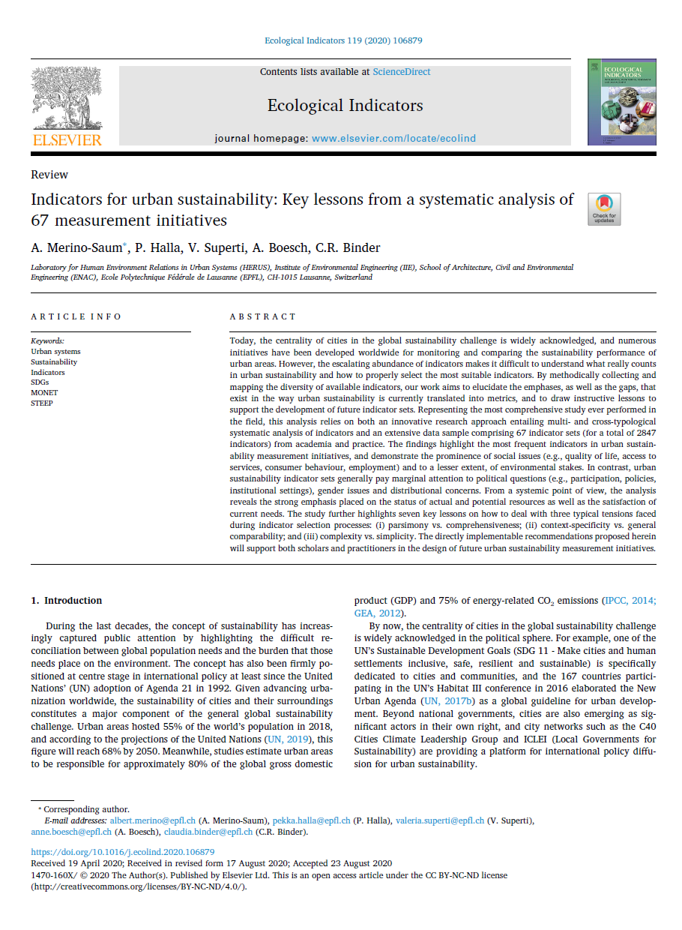
Topic 1
«How could we enhance our indicator sets ?»
https://doi.org/10.1016/j.ecolind.2020.106879

Slide 4
Paper introduction
Sustainability Assessment of Urban Systems

Slide 5
Paper introduction (1A and 1B)
To read : Abstract + Introduction
Who are the authors? What are their expertise ?
What is the scope of the journal ?
What is the research question raised by the authors ? What are the methods ?

Slide 6
Methods and data
Sustainability Assessment of Urban Systems

Slide 7
Group 1A
To read : Section 3
What are the six steps followed by the researchers ? Introduce briefly the method that are used.

Slide 8
Group 1A
To read : Section 3
What are the “typologies” in the article ? Why are they useful in the article ? To what extent is the selection of the three typologies relevant ?

Slide 9
Results
Sustainability Assessment of Urban Systems

Slide 10
Group 1A
To read : Section 4
According to the article, what are the issues that are the most prominent in the indicator sets ?
According to the article, what are the domains that are the most prominent in the indicator sets ?

Slide 11
Group 1B
To read : Section 4 and 5
According to the authors, which type of conceptual framework is most frequently used? What are the reasons for this? Do you see any additional reasons?

Slide 12
Group 1B
To read : Section 4 and 5
The author views the size of the indicator set as a crucial parameter. Can you explain why? Additionally, identify and justify what the "ideal" size of the indicator set would be for assessing a European city that aims to evaluate both its performance and its ranking.

Slide 13
Group 1B
To read : Section 5
Identify 5 recommendations given by the authors in section 5.

Slide 14
Results
Sustainability Assessment of Urban Systems

Slide 15
Group 1A and 1B
To read : Section 5 and Conclusion
  What are the strengths and weaknesses of the authors’ work ?

Slide 16
Group 1A and 1B
To read : Section 5 and Conclusion
  The topic was : «How could we enhance our indicator sets ?»
  What are the main contributions of the authors to this question ?

